Slide 1

Building & Mining Knowledge Graphs
(KEN4256)
Lecture 7: Knowledge Graph Embeddings

Slide 2
© 2024 by Michel Dumontier and the Institute of Data Science at Maastricht University is licensed under Attribution 4.0 International
To view a copy of this license, visit http://creativecommons.org/licenses/by/4.0/
This license requires that reusers give credit to the creator. It allows reusers to distribute, remix, adapt, and build upon the material in any medium or format, even for commercial purposes.
id: KEN4256_L7
version: 1.2024.0
created: February 9, 2019
last modified: March 26, 2024
published on: March 26, 2024

Slide 3
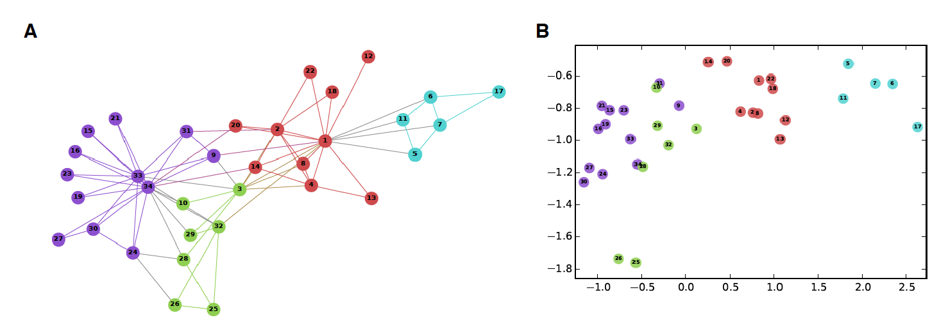
Knowledge Graph Embeddings (KGEs)
KG are symbolic representations of entities and relations, which is favourable for logical inference, question answering, and information retrieval
KG embeddings encode the KGs into low-dimensional numerical vectors, which can be used as features for ML (statistical inference)
image source: Hamilton, W.L., Ying, R. and Leskovec, J., 2017. Representation learning on graphs: Methods and applications. arXiv preprint arXiv:1709.05584.

Slide 4
Knowledge Graph Completion Tasks
Node Classification
categorize nodes to their semantic type: AlfredHitchcock is a Person
Link Prediction
predict s given (p, o) or o given (s, p):
(?s, directorOf, psycho)
Triple Classification
Verify whether an unseen triple fact (s, p, o) is true or not:
(AlfredHitchcock, directorOf, psycho) is True or False?
castMember
Alfred Hitchcock
directorOf
North by Northwest
castMember
Psycho
directorOf

Slide 5
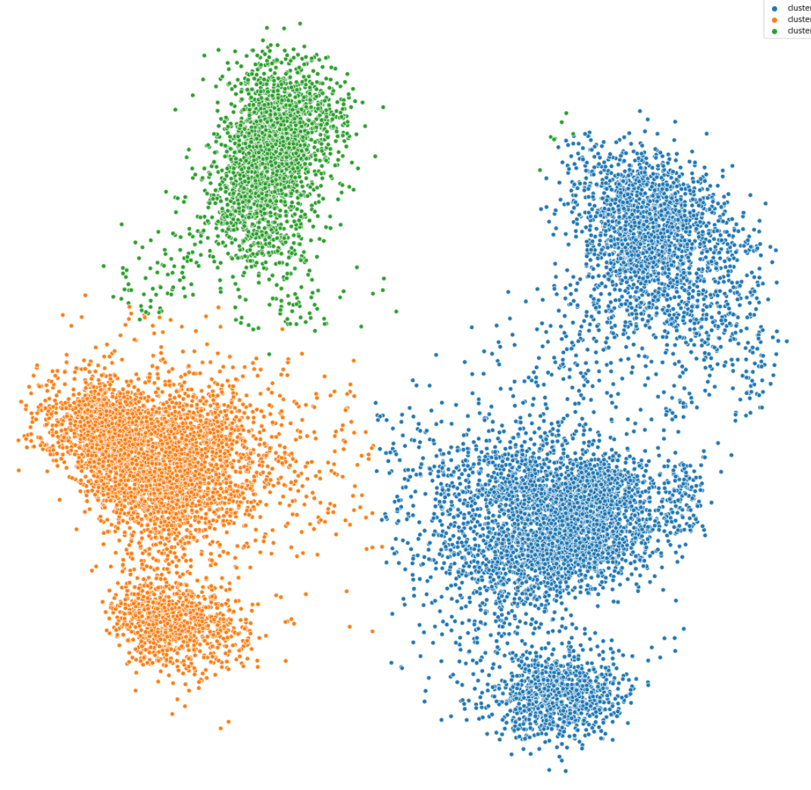
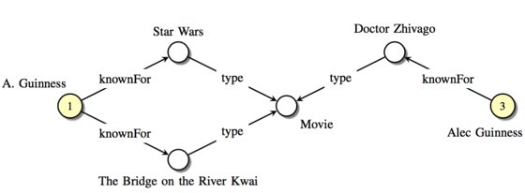
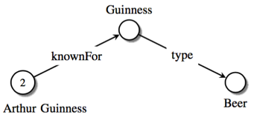
KGE Applications
Entity Clustering & Classification
Entity Alignment
Slide: https://kge-tutorial-ecai2020.github.io/

Slide 6
Low-dimensional vector embeddings
Map high-dimensional data into low-dimensional vector space.
Efficient representation
Allow vector operations (addition, subtraction, cosine, etc.)
Capture semantic relationships
King
King - Queen = Man - Woman
Man
Queen
Woman

Slide 7
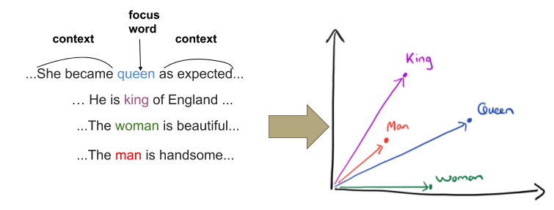
word2vec
Represents each word with a low-dimensional vector, called word embedding where semantically and syntactically closer words appear closer in the vector space.
King - Queen = Man - Woman
Distributed Representations of Words and Phrases and their Compositionality, Mikolov T. etl., 2013.

Slide 8
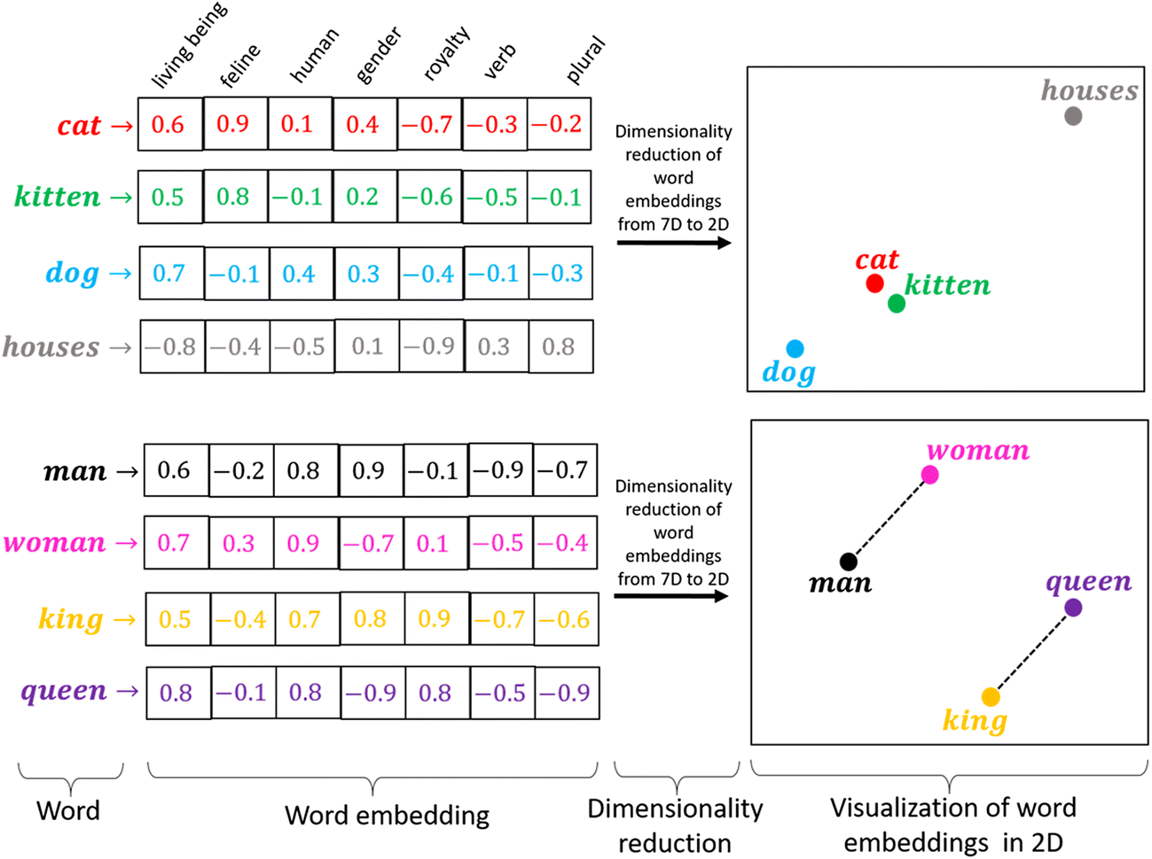
Word Embeddings

Slide 9
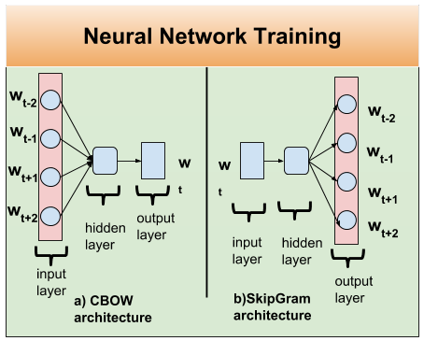
word2vec architectures
2 basic neural network models:
Continuous Bag of Word (CBOW):
use a window of word to predict the target word
Skip-Gram (SG):
use a word to predict the surrounding ones in window.

Slide 10
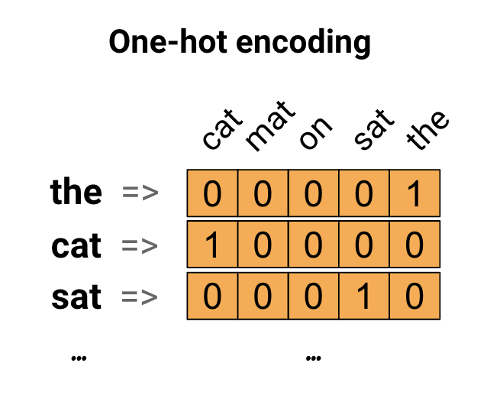
One-hot encoding for text data
Sentence:
"The cat sat on the mat".
https://www.tensorflow.org/text/guide/word_embeddings

Slide 11
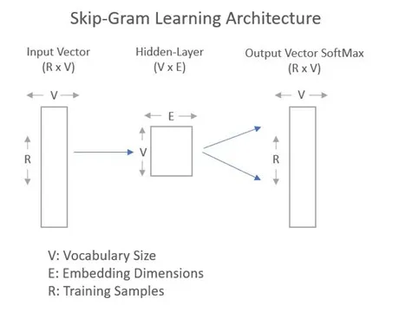
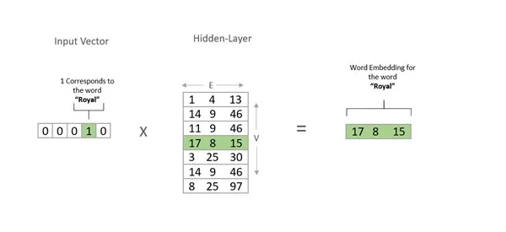
Skip-Gram Algorithm
Source: https://www.hackdeploy.com/word2vec-explained-easily/

Slide 12
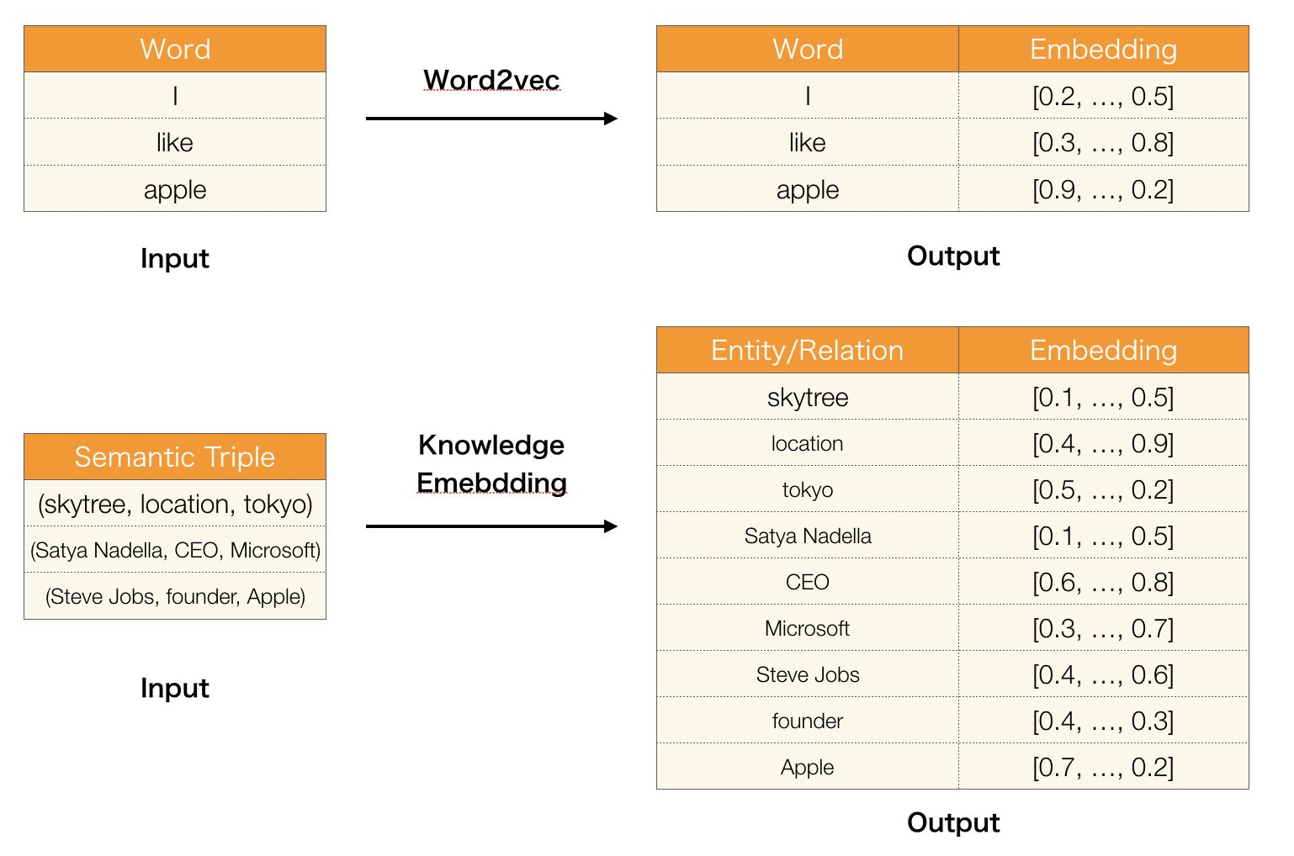
Knowledge Graph Embedding
Embedding
Source: https://towardsdatascience.com/summary-of-translate-model-for-knowledge-graph-embedding-29042be64273

Slide 13
KG Representation in Vector Space
Key Idea: Model entities and relations in embedding space
Edges in KG are represented as triple or 3-tuple (h,r,t) denoting the head (subject), relation (predicate), and tail (object).
Given a triple (h,r,t), the goal is that the embedding of (h,r) should be close to the embedding of t
How to embed (h,r) ?
How to define score f_{r}(h,t)?
Score f_{r} is high if (h,r,t) exists, else f_{r} is low

Slide 14
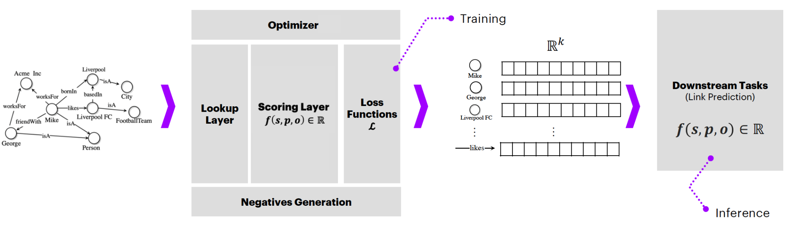
Structure for KGE Models
Image: https://kge-tutorial-ecai2020.github.io/

Slide 15
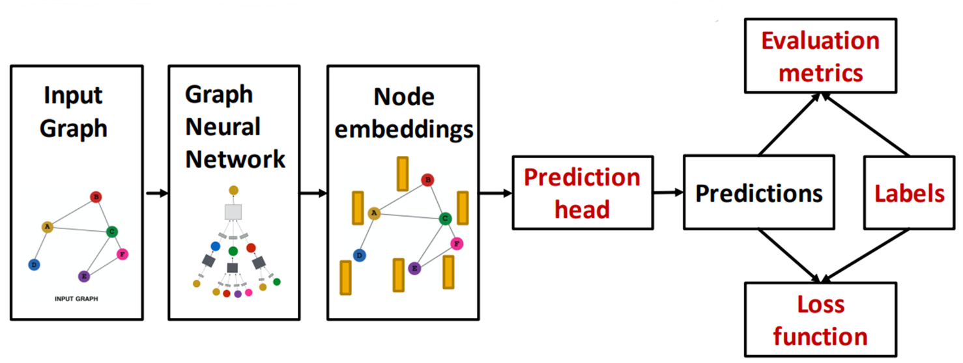
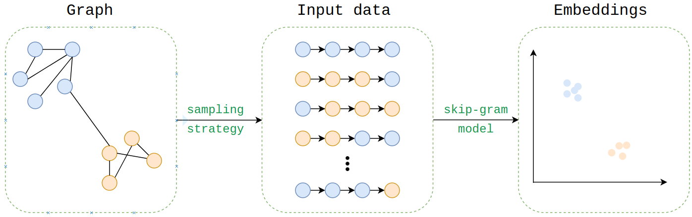
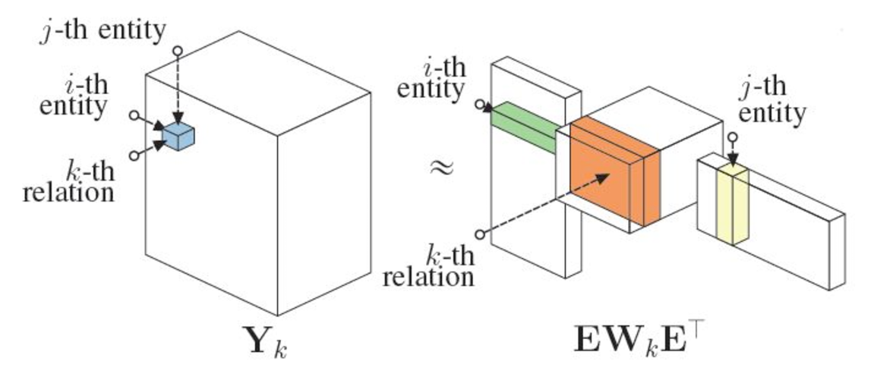
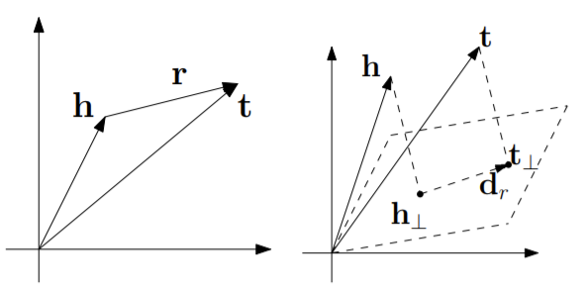
KGE Approaches
We focus on GNN in this course!
Random Walk based Embeddings
RDF2Vec
Graph Neural Networks
Factorization based Embeddings
Translation based Embeddings
TransE
RotatE
RESCAL

Slide 16
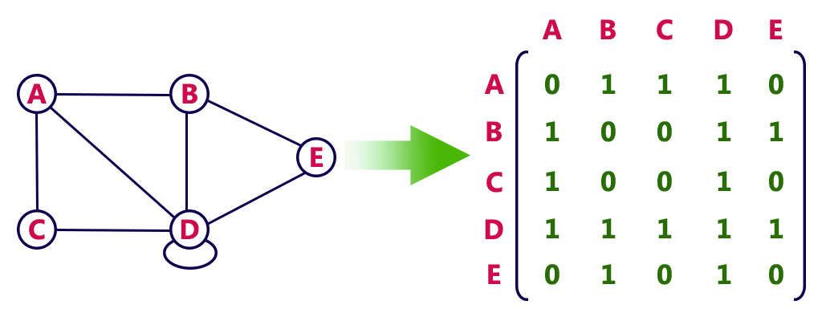
One-hot encoding for graph data
http://www.btechsmartclass.com/data_structures/graph-representations.html

Slide 17

Low-dimensional vector
representational vectors
operational vectors
A
0.6
0.1
-0.7
0.5
B
0.3
0.2
-0.4
0.3
C
0.5
0.3
-0.6
0.6
D
0.8
0.4
-0.1
0.9
E
0.7
0.8
-0.2
0.2
one-hot vector representation of entities
sparse vector
vector length = total number of entities
vector representation produced by an embedding algorithm
dense vector
vector length << total number of entities

Slide 18
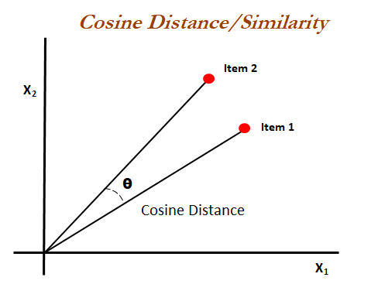
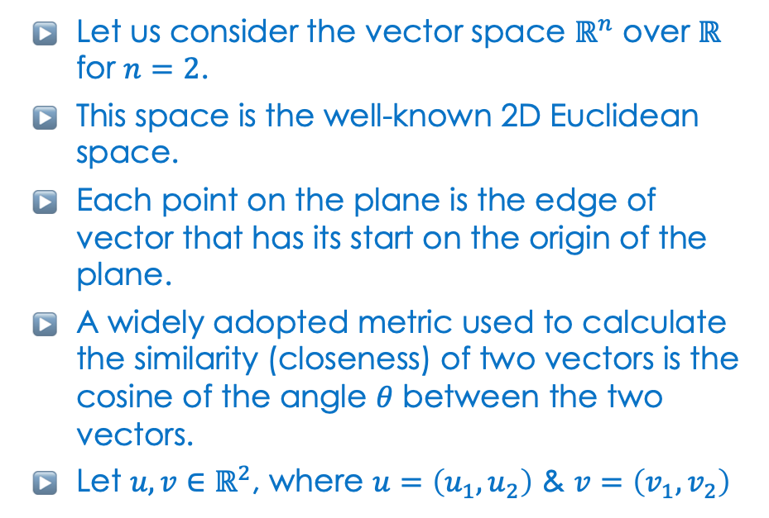

Scoring function: cosine similarity

Slide 19
RDF2Vec
generates (random) walks on the knowledge graph data to be used as input for word2vec neural network
Rdf2vec: Rdf graph embeddings for data mining. Ristoski, Petar, and Heiko Paulheim. International Semantic Web Conference. Springer, Cham, 2016.

Slide 20

Random walks on graphs
H
G
B
C
F
B
C
G
B
F
B
H
G
B
C
E
A
C
E
B
H
G
F
How many random walks and of what length need to be started from each node to cover the graph?
B
C
E
F

Slide 21
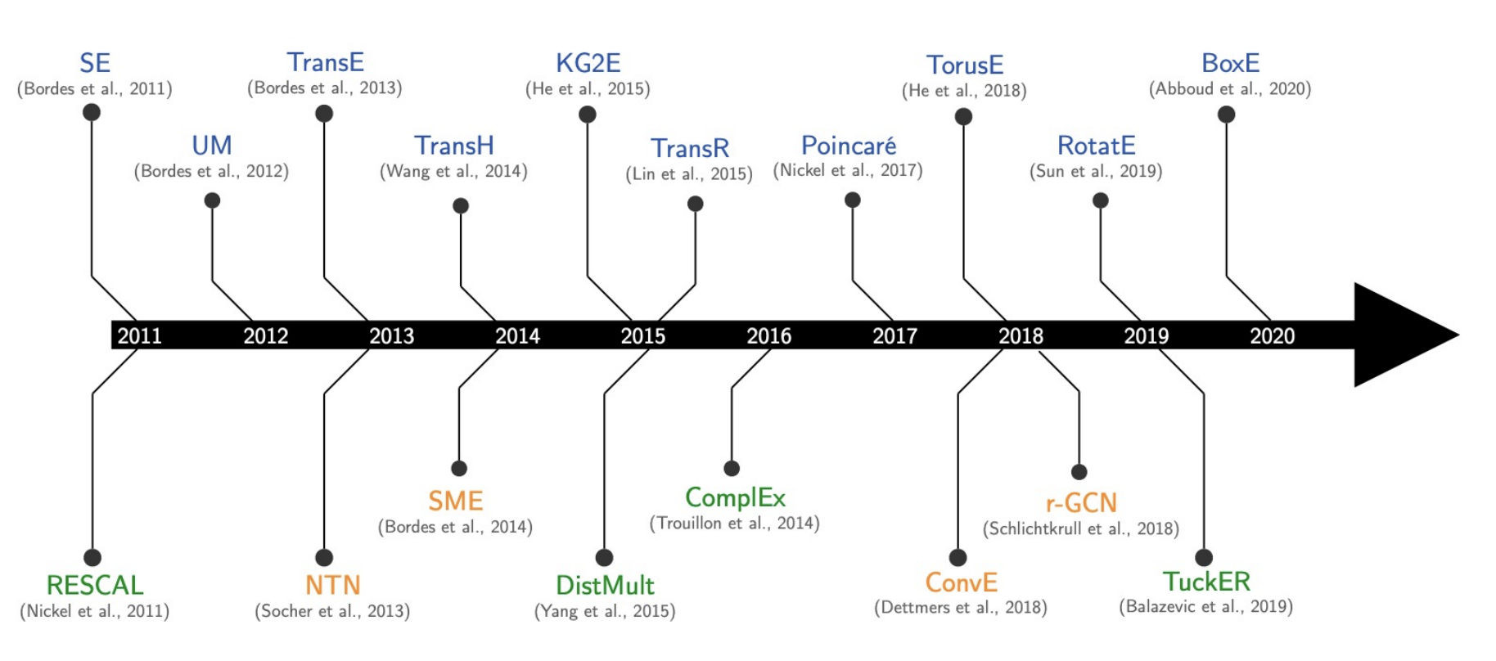
Many KG Embedding Models

Slide 22
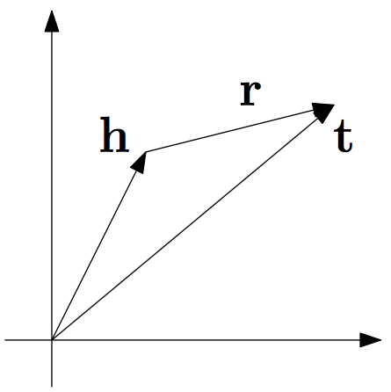
TransE
If a fact (h,r,t) holds, then h +r should be close to t
Otherwise h+r should be distant to t
Scoring function is L1 or L2 norm (distance measure)
= ∥e_{h}+r_{p}-e_{t}∥
Pros:
Simple
Computationally efficient
Cons:
Cannot capture some properties (transitivity, anti-symmetry)
Cannot handle 1-N, M-N relations

Slide 23
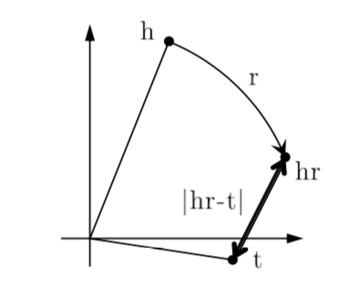
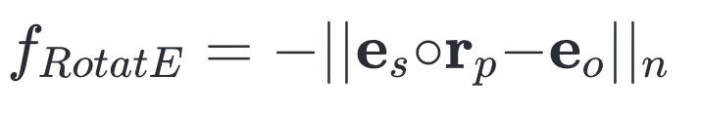
RotatE
relations modelled as rotations in complex space R: elementwise
product between complex embeddings.

Slide 24
Capturing KG properties
Symmetry
A relation RR on a set A is symmetric if, for all x,y∈A whenever xRy, then yRx. In other words, if one element is related to another, the reverse is also true.
<Alice marriedTo Bob> . <Bob marriedTo Alice>
Asymmetry
A relation R on a set A is asymmetric if, for all x,y∈A, whenever xRy then it is not the case that yRx. This means that if one element is related to another, the reverse relation cannot exist between them.
<Alice childOf Jack>
Inversion
The inverse of a relation R on a set A, denoted as R⁻¹, is defined such that for all x,y∈A, xR⁻¹y if and only if yRx. Essentially, the inverse of a relation reverses the direction of that relation.
<Alice childOf Jack>
<Jack fatherOf Alice>
Composition
The composition of two relations R and S on a set A, denoted as R∘S, is defined such that for all x,z∈A, x(R∘S)z if and only if there exists a y∈A such that xRy and ySz. This describes a situation where the existence of intermediary elements allows for a compound relationship to be established between two elements.
<Alice childOf Jack> + <Jack siblingOf Mary> => <Alice nieceOf Mary>

Slide 25
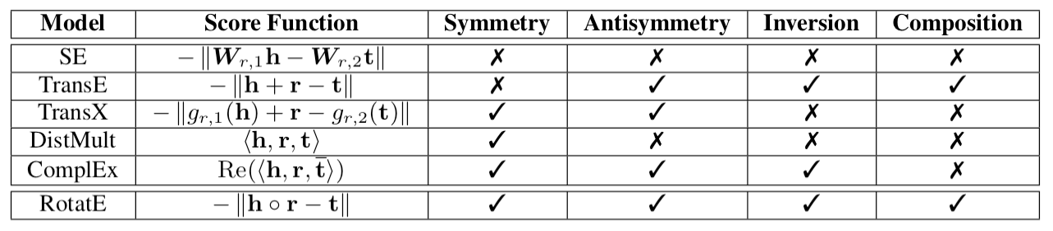
Knowledge Graph Embedding
Intuition: Predicate embedding captures the relation (+/x) between head and tail embeddings

Slide 27
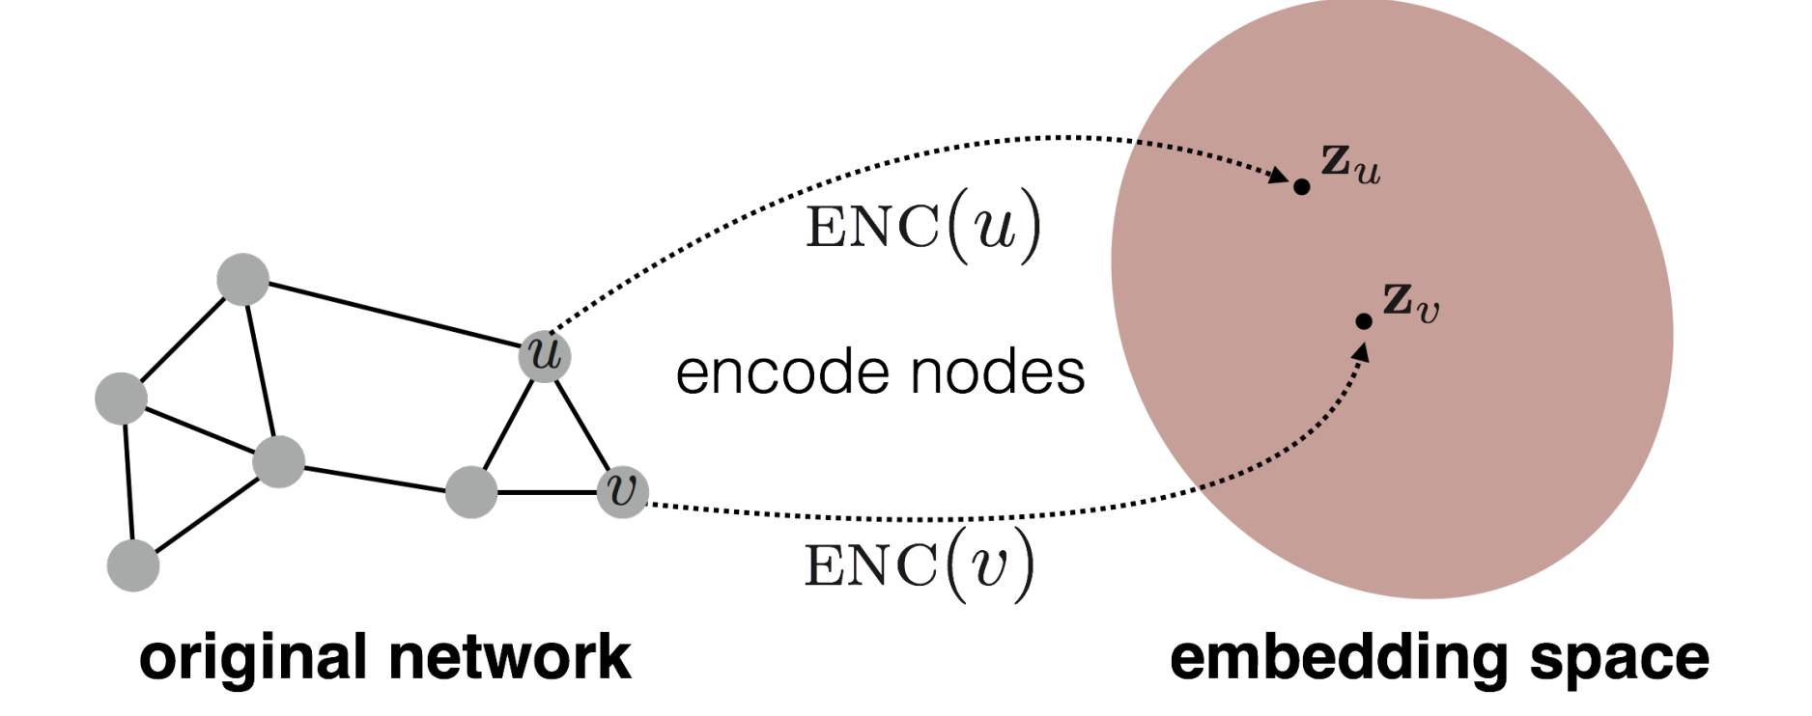
Graph Neural Networks
Goal: encode nodes so that similarity in embedding space (i.e. dot product) approximates similarly in original graph
Node classification
Link prediction
Graph classification
Anomalous node detection
Clustering
etc…

Slide 28
Learning Node Embeddings
Encoder maps from nodes to embeddings
Define a node similarity function (i.e., a measure of similarity in the original network)
Decoder maps from embeddings to the similarity score
Optimize the parameters of the encoder so that:
similarity (u,v) ≅ ENC(u) . ENC(v)
Embedding z_{u}
Embedding z_{v}
dot product operator

Slide 29
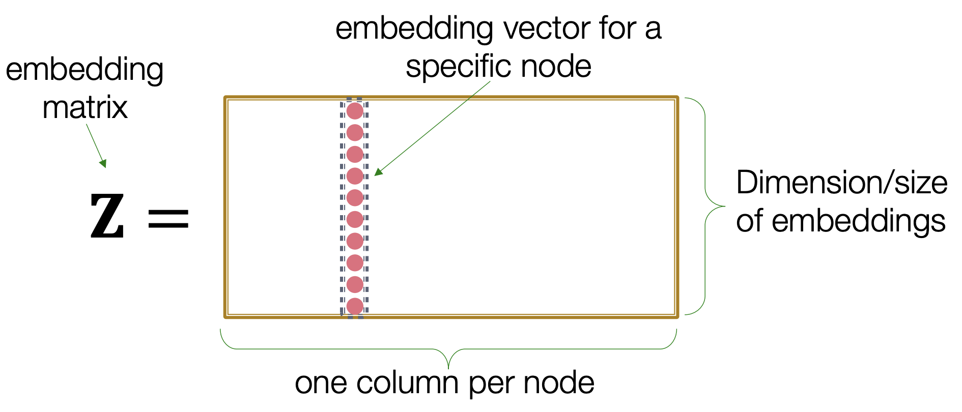
“Shallow” Encoding
Simplest encoding approach: encoder is just an embedding-lookup

Slide 30
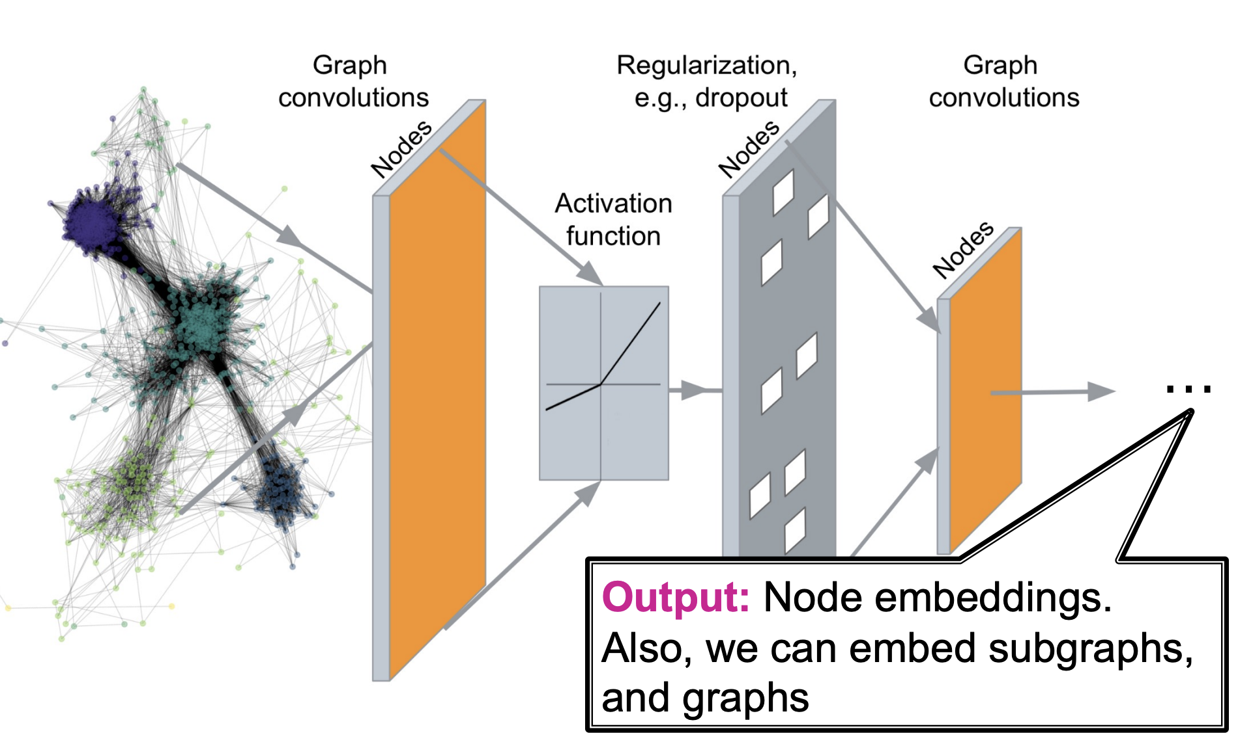
Deep Graph Encoders

Slide 31
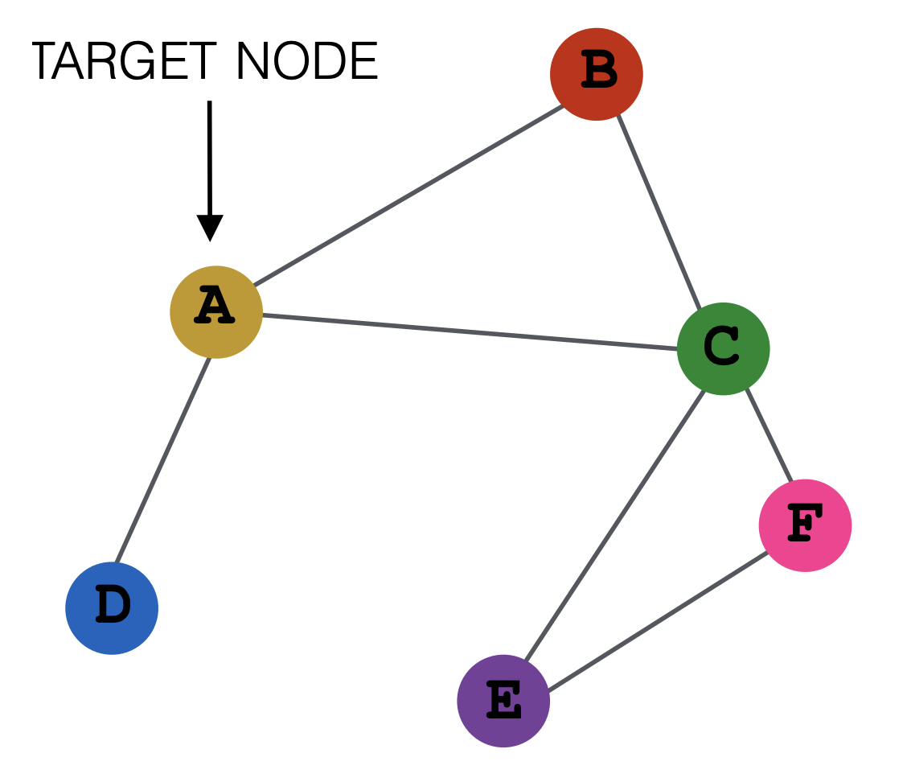
Node Prediction
Directly train the model for node prediction
Node’s neighborhood defines a computation graph
Learn how to propagate information across the graph to compute node features
Nodes aggregate information from their neighbors using neural networks
Drug type?
`

Slide 32
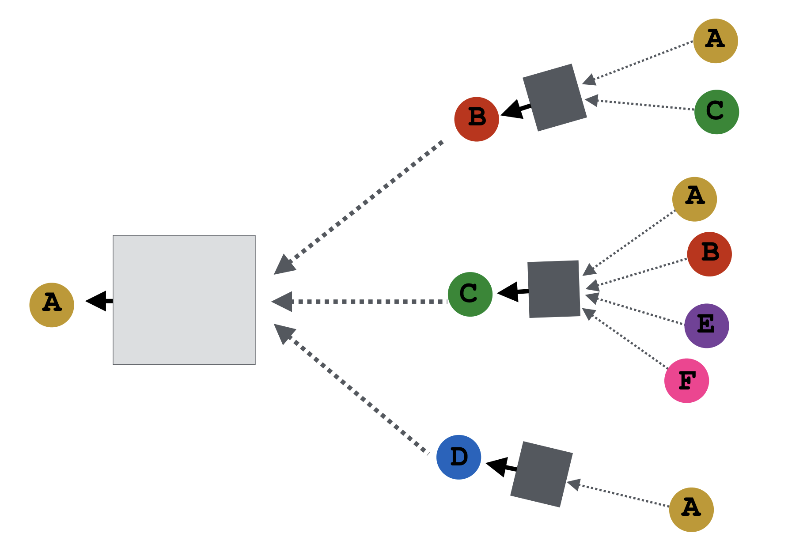
Aggregate Neighbour Embeddings
Key idea: Generate node embeddings based on local network neighborhoods
Layer 2 embeddings
Layer 1 embeddings
Computation Graph
Agg
Target
Embedding
Aggregation function
Notes:
(1) Define a neighborhood aggregation function
(2) Define a loss function on the embeddings
(3) Train on a set of nodes, i.e., a batch of compute graphs
(4) Generate embeddings for nodes as needed

Slide 33
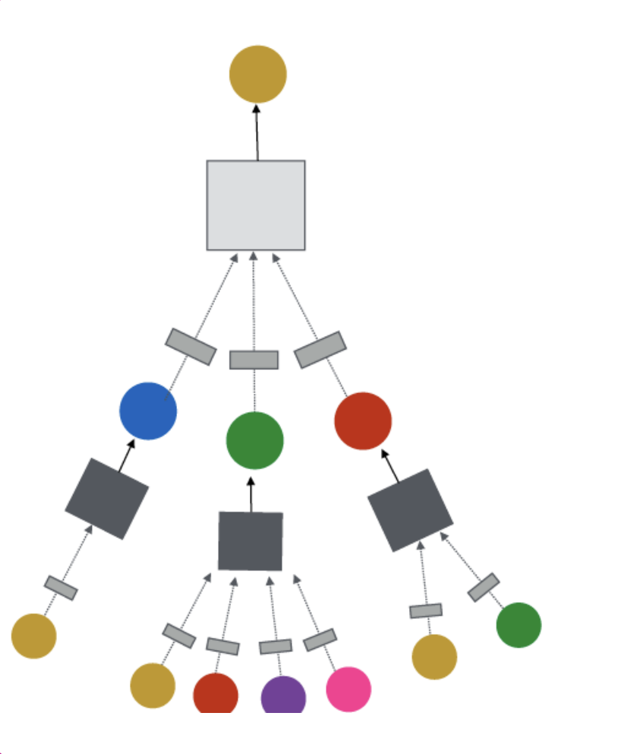
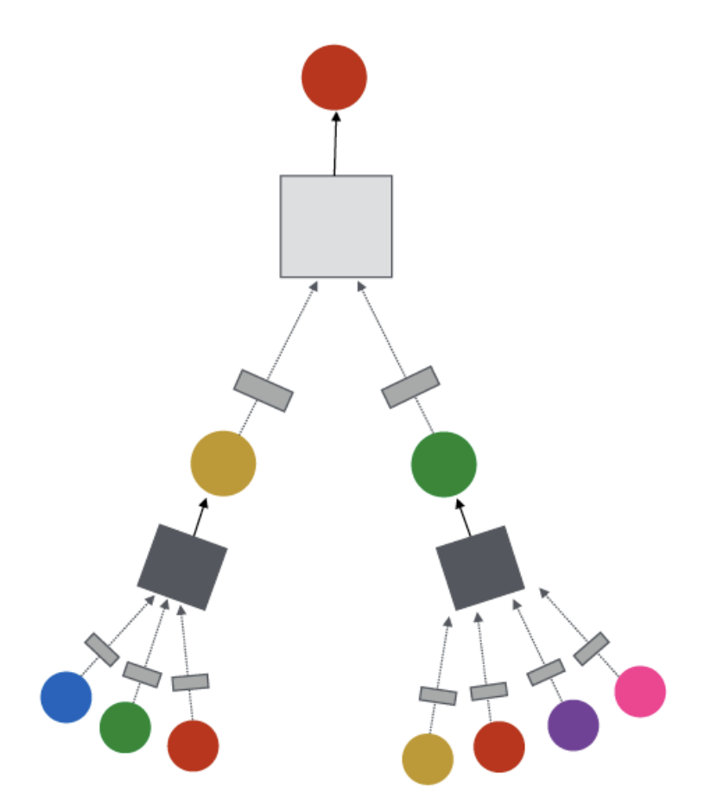
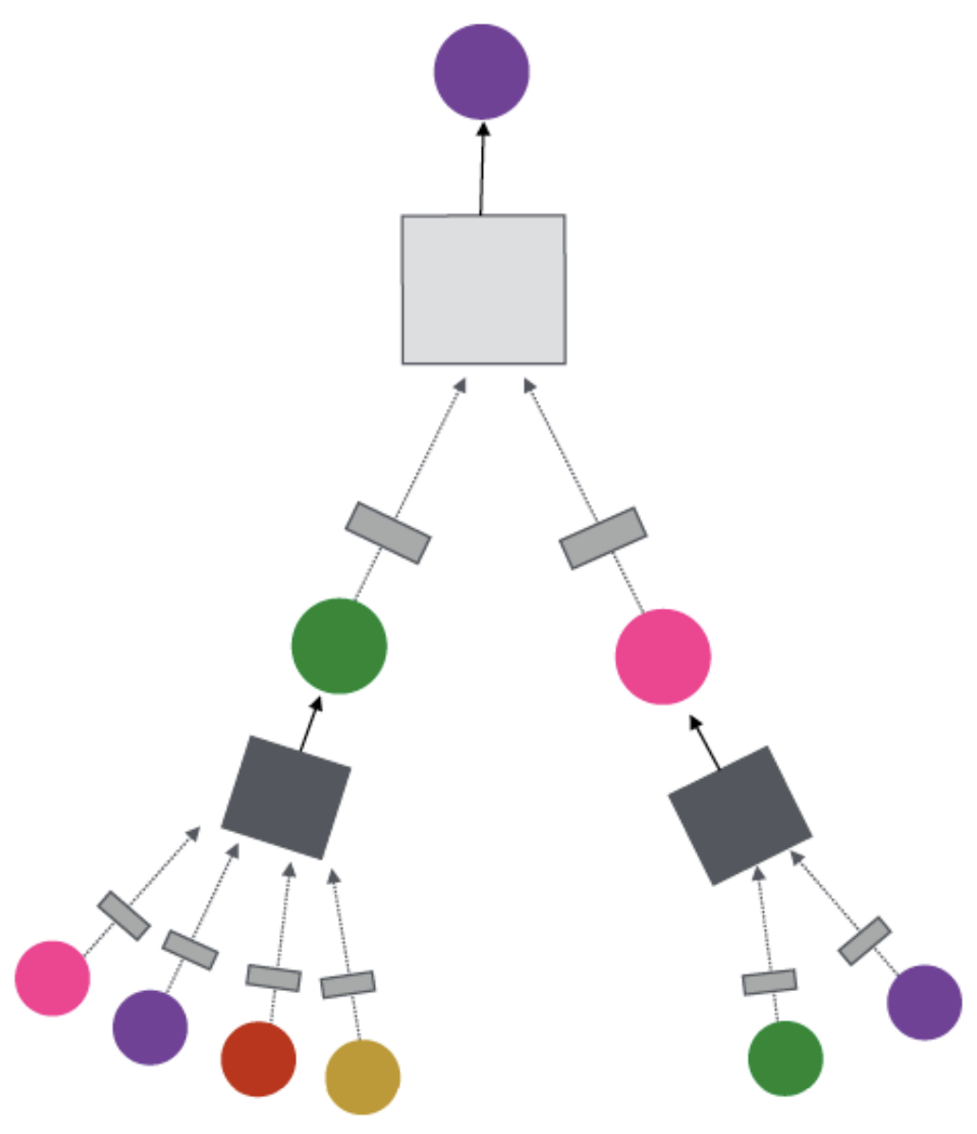
Inductive Capacity
The same aggregation parameters learned using neural networks are shared for all nodes
Shared Parameters
Shared Parameters
Apply to new nodes, e.g., train on protein interaction graph from model organism A and generate embeddings on newly collected data about organism B
Computation graph of Node A
Computation graph of Node B

Slide 34
A Single GNN Layer
There are two types of parameters in the model:
Message computation: each node u creates an information message m_{u}, represented by its embedding vector h_{u} , parameterized with neural network to send to other nodes
Example: a linear layer m_{u} = W h_{u}
Message Aggregation: node v will aggregate messages from its neighbors u
Example: sum(), mean(), or max() aggregator
h_{v} = Mean({m_{u} | u a neighbour of v })

Slide 35
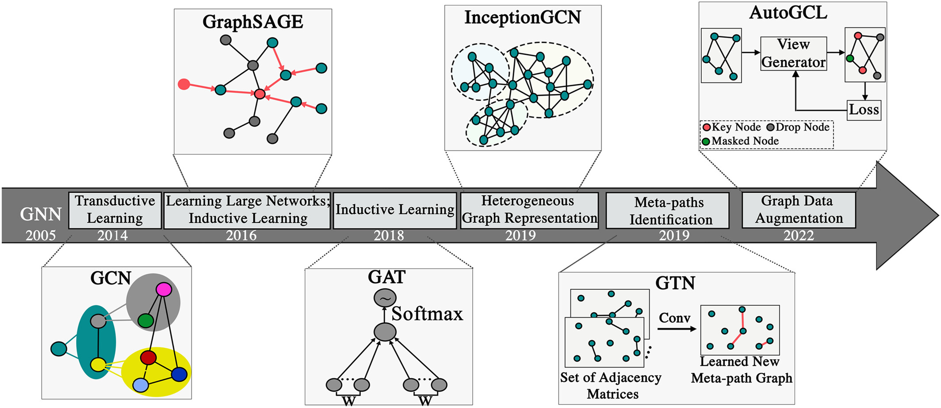
Other Variations
iRADIOLOGY, Volume: 1, Issue: 2, Pages: 151-166, First published: 27 June 2023, DOI: (10.1002/ird3.20)
Notes:
Graph Convolutional Network (GCN)
Key Features:
Aggregates information from a node's immediate neighbors.
Utilizes a fixed graph convolutional operation.
Use Cases: Node classification, link prediction, community detection.
GraphSage (Graph Sample and Aggregation) (main: self rep is concated)
Key Features:
Nodes sample and aggregate information from sampled neighbors.
Allows for inductive learning on unseen nodes.
Use Cases: Scalable learning on large graphs, node classification
Graph Attention Network (GAT)
Key Features:
Assigns attention scores to each neighbor during aggregation.
Allows nodes to selectively attend to informative neighbors.
Use Cases: Node classification, link prediction, recommendation systems.

Slide 36
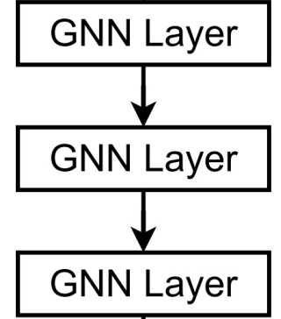
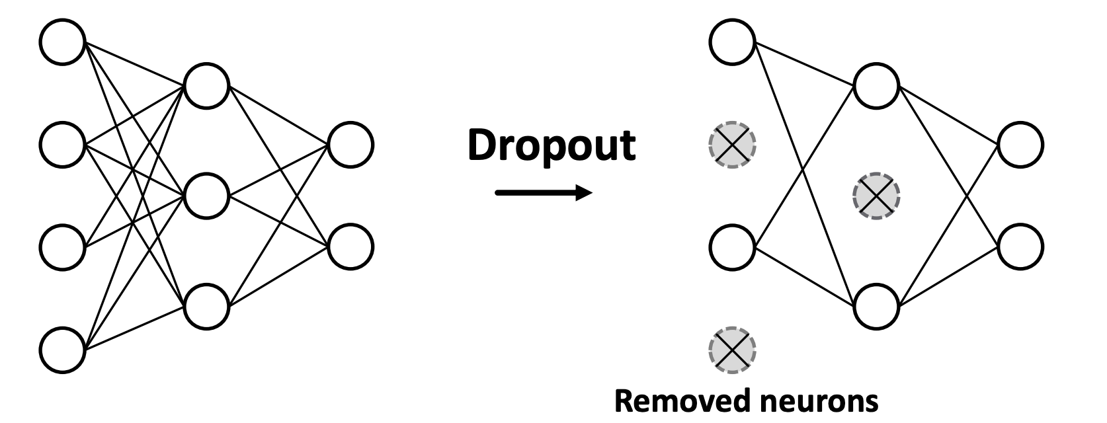
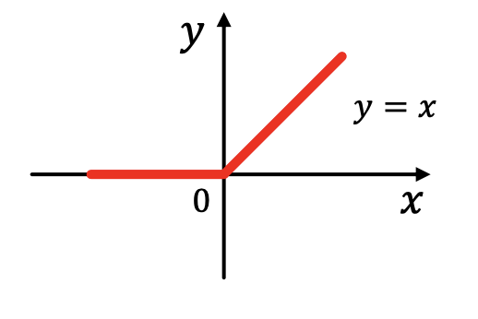
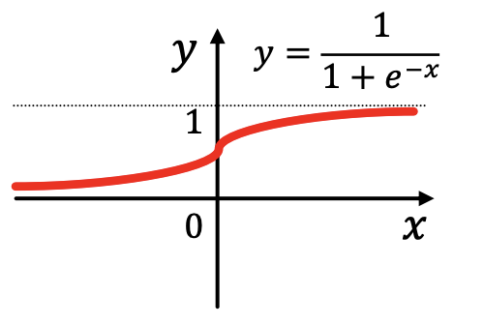
In Practice
To make GNN work really well, need also the following techniques:
Stack GNNs, increases expressivity and works great in practice
Skip connections, to prevent over-smoothing due to larger receptive fields by adding back original input
A GNN module
Batch Normalization, stabilizes training by re-centering and re-scaling parameters
Dropout, prevents overfitting by dropping random links
Activation, improves expressivity
ReLu
Sigmoid

Slide 37
Training Framework
Forward Pass

Slide 38
Forward Pass
B
B
A
A
D
C
D
C
Compute messages
B
A
Propagate messages
D
C
B
Aggregate
A
D
C

Slide 39
Prediction & Learning
The goal of learning is to minimize the loss between predictions and labels:
B
A
B
D
C
Forward
Pass
A
D
C
Output
Probabilities
Node
Embeddings
Output
Labels
A
0.4
1
Backpropogate these errors to update the parameters
Prediction Head
&
Loss Computation
B
0.7
1
Prediction Head is typically a fully connected layer (of size embedding dimension x number of classes), followed by prediction function
C
0.91
1
D
0.1
0

Slide 40
2D Interpretation
With linear layers, this process is the same as learning embeddings such that node representations are linearly separable by a hyper-plane, i.e. binary/multi-label classification with graph input
B
Feature 2
A
D
C
Feature 1

Slide 41
Evaluation Metrics
For Binary Node Classification, the following metrics can be used:
TP + TN
Accuracy:
|dataset|
TP
Precision (P):
TP + FP
TP
Recall (R):
TP + FN
F1 - score:
2 P x R
P + R

